Slide 1
Bean and Bean lifecycle

Slide 2
Bean Scoping
Singleton : Default - Single Object instance per container
Prototype : A new instance is created each time the bean is referenced
Request : A new instance is created one per request (Web Aware context)
Session : A new instance is created one per session(Web Aware context)
Custom : Can define own rules (Advanced)
<bean id="createService" class="org.poc.spring.service.CreateServiceImpl” scope="prototype” />

Slide 3
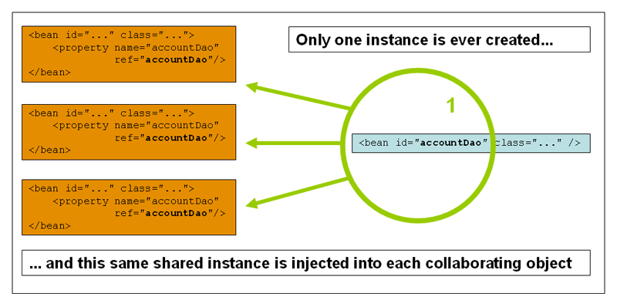
Singleton
Default - Single Object instance per container

Slide 4
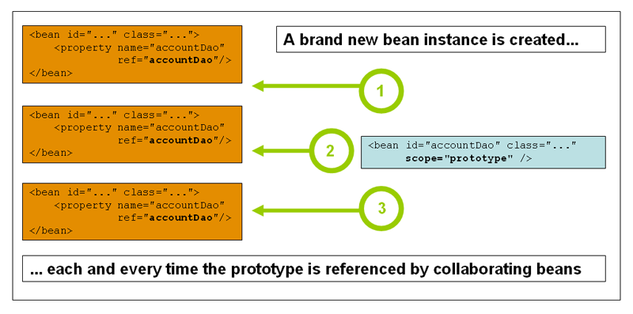
Prototype
A new instance is created each time the bean is referenced

Slide 5
Bean Lifecycle
3 phases
Initialization phase
Use Phase
Destruction phase
Initialization
Use
Destruction

Slide 6
Initialization phase
// Create the application from the configuration
ApplicationContext context =
new ClassPathXmlApplicationContext(new String[] {
“application-config.xml”,
“oracle-infrastructure-config.xml”
});
Initialization phase completes when you create the context

Slide 7
Initialization phase
1. Load Bean
Definitions
2. Initialize Bean instances
a)Load Bean Definitions
b)Run Bean Factory Post processors
a)Each bean eagerly instantiated,
dependencies injected
b)Bean Post processing phase
c)Bean fully initialized

Slide 8
Load Bean Definitions
application-config.xml
<beans>
<bean id=“myService” …
<bean id=“myDAO”…
</beans>
Application Context
myService
myDAO
dataSource
test-infrastructure-config.xml
<beans>
<bean id=“dataSource” …
</beans>
Can modify the definition of
any bean in the factory
before any objects are created
BeanFactoryPostProcessors

Slide 9
1. Load bean definitions
The XML files are parsed
Bean definitions are loaded into the context’s BeanFactory
- Each indexed under its id
Special BeanFactoryPostProcessor beans are invoked
- Can modify the definition of any bean

Slide 10
Bean Factory Post Processing
Apply changes to bean definitions
Can write your own by implementing BeanFactoryPostProcessor Interface
Eg: PropertyPlaceholderConfigurer susbstitutes ${variables} with values from property files

Slide 11
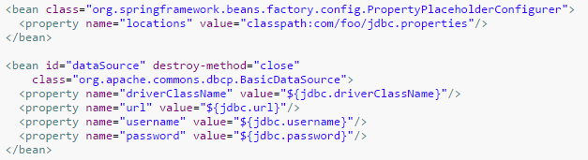

Property Placeholder configurer

Slide 12
2. Initialize Bean instances
Each Bean ‘eagerly instantiated’
Dependencies injected
Every bean goes through PostProcessing
After post processing, bean is ready for use

Slide 13
Bean Initializing Steps
Bean Instantiated
Dependencies Injected
Bean Post
Processed
Bean
Ready
For Use

Slide 14
Bean Post processing
Further broken into
- Initialization CallBacks
- Additional Post processing (wrap beans into proxies)

Slide 15
Bean Initialization Callbacks
@PostConstruct
Init-method
InitializingBean
<bean id="exampleInitBean" class="examples.ExampleBean" init-method="init"/>
public class AnotherExampleBean implements InitializingBean
{
public void afterPropertiesSet()
{ // do some initialization work }
}
unnecessarily couples the code to Spring.

Slide 16
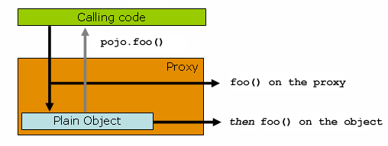
BeanPostProcessor - Proxying
Bean Post processor may wrap your bean in a dynamic proxy and add enterprise behaviour transparently

Slide 17
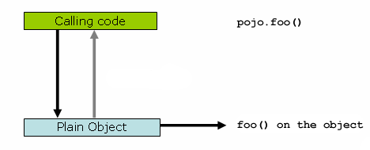
Bean – Use phase
Invoking a bean obtained from the context, the application is used
Bean may be used straightforward
OR
If wrapped in a dynamic proxy,
Bean gets powered up

Slide 18
Bean Destruction
When you close the context, destruction phase completes
//context.close();
Techniques
@PreDestroy – annotation on any clean up method
destroy-method -
<bean id="exampleInitBean" class="examples.ExampleBean" destroy-method="cleanup"/>
DisposableBean
public class AnotherExampleBean implements DisposableBean
{
public void destroy()
{ // do some destruction work (like releasing pooled connections) }
}
unnecessarily couples
the code to Spring.

Slide 19
Bean Definition Inheritance
When several beans are configured in the same way, use inheritance to define common configuration once
<beans>
<bean id=“pool-A” class=“myExample.TestDataSource”>
<property name=“URL” value=“jdbc:db2:@server-a:1521:MYDS” />
<property name=“user” value=“admin” />
</bean>
<bean id=“pool-B” class=“myExample.TestDataSource”>
<property name=“URL” valuejdbc:db2:@server-b:1521:MYDS” />
<property name=“user” value=“admin” />
</bean>
<bean id=“pool-C” class=“myExample.TestDataSource”>
<property name=“URL” valuejdbc:db2:@server-c:1521:MYDS” />
<property name=“user” value=“admin” />
</bean>
</beans>

Slide 20
Bean Definition Inheritance
<beans>
<bean id=“abstractPool”
class=“myExample.TestDataSource” abstract=“true”>
<property name=“user” value=“admin” />
</bean>
<bean id=“pool-A” parent=“abstractPool”>
<property name=“URL” value=“jdbc:db2:@server-a:1521:MYDS” />
</bean>
<bean id=“pool-B” parent=“abstractPool”>
<property name=“URL” value=“jdbc:db2:@server-b:1521:MYDS” />
</bean>
<bean id=“pool-C” parent=“abstractPool”>
<property name=“URL” value=“jdbc:db2:@server-c:1521:MYDS” />
</bean>
</beans>
Will not be instantiated
Each pool inherits its parent configuration

Slide 21
Overriding Parent Bean definition
Not abstract
<beans>
<bean id=“defaultPool” class=“com.oracle.jdbc.pool.OracleDataSource”>
<property name=“URL” value=“jdbc:oracle:thin:@server-a:1521:MYDS” />
<property name=“user” value=“admin” />
</bean>
<bean id=“pool-B” parent=“defaultPool”>
<property name=“URL” value=“jdbc:db2:@server-b:1521:MYDS” />
</bean>
<bean id=“pool-C” parent=“defaultPool” class=“example.SomeOtherPool”>
<property name=“URL” value=“jdbc:db2:@server-c:1521:MYDS” />
</bean>
</beans>
Override URL
Overrides class

Slide 22
Inner Beans
Sometime you may not need other beans to reference your bean
Opt for Inner Beans
A <bean/> element inside the <property/> or <constructor-arg/> elements defines a so-called inner bean.
<bean id="outer" class="...">
<!-- instead of using a reference to a target bean, simply define the target bean inline -->
<property name="target">
<bean class="com.example.Person"> <!-- this is the inner bean -->
<property name="name" value="Fiona Apple"/>
<property name="age" value="25"/>
</bean>
</property>
</bean>
Inner bean has no id (it is anonymous)
Cannot be referenced outside this scope

Slide 23
Introducing PropertyEditor (1)
In XML all literal values are text strings
In your code there are often rich object types
<bean id=“phoneValidator” class=“sample.PhoneValidator”>
<property name=“pattern” value=“[0-9]{3}-[0-9]{3}-[0-9]{4}” />
</bean>
A text string
public class PhoneValidator {
private Pattern pattern;
public void setPattern(Pattern pattern) {
this.pattern = pattern;
}
}
A rich object with behavior

Slide 24
Introducing PropertyEditor (2)
Your code should not be burdened with the responsibility of type conversion
Spring will convert for you using a PropertyEditor
Comes with many property editors pre-installed
You may write and install your own

Slide 25
Built-In PropertyEditor implementations
See the org.springframework.beans.propertyeditor package
Some editors available builtin
NumberEditor converts to the Number types
BooleanEditor converts to Boolean
DateEditor converts to java.util.Date
ResourceEditor converts to a Resource
PropertiesEditor converts to java.util.Properties
ByteArrayEditor converts to a byte[]
LocaleEditor converts to a Locale

Slide 26
Built-In PropertyEditor Example
<bean id=“sessionFactory”
class=“org.springframework.orm.hibernate3.support.
LocalSessionFactoryBean”>
…
<property name=“hibernateProperties”>
<value>
hibernate.format_sql=true
hibernate.jdbc_batch_size=30
</value>
</property>
</bean>
String-encoded properties
public class LocalSessionFactoryBean {
public void setHibernateProperties(Properties p) { …
}
Typed java.util.Properties object

Slide 27
Implementing Your Own PropertyEditor
Create a custom editor by extending PropertyEditorSupport
Override setAsText(String) to convert from String
Override getAsText() to format the value (optional)
public class PatternEditor extends PropertyEditorSupport {
public void setAsText(String text) {
setValue(text != null ? Pattern.compile(text) : null);
}
public String getAsText() {
Pattern value = (Pattern) getValue();
return (value != null ? value.pattern() : “”);
}
}
Converts from String

Slide 28
Installing your Custom Property Editor
Use a CustomEditorConfigurer to install your custom editor (a BeanFactoryPostProcessor)
<bean class=“org.springframework.beans.factory.config.
CustomEditorConfigurer”>
<property name=“customEditors”>
<map>
<entry key=“javax.util.regex.Pattern” value=“example.PatternEditor” />
</map>
</property>
</bean>
Fully-qualified convertible type
The PropertyEditor to
perform conversions
to that type
*A PatternEditor implementation is built-in as of Spring 2.0.1

Slide 29
Importing Configuration Files (1)
Use the import tag to encapsulate including another configuration file
application-config.xml
<beans>
<import resource=“messaging-config.xml” />
<import resource=“webservices-config.xml” />
<import resource=“misc-config.xml” />
</beans>
system-test-config.xml
<beans>
<import resource=“application-config.xml”/>
<bean id=“dataSource” class=“example.TestDataSourceFactory” />
</beans>
new ClassPathXmlApplicationContext(“system-test-config.xml”);
Client only imports one file
Notes:
Useful for “top-level” configuration files that assemble a final configuration

Slide 30
Importing Configuration Files (2)
Promotes splitting configuration into logical groups of bean definitions
Enables reuse across modules within an application
Complements the option of creating an ApplicationContext from multiple files
ApplicationContext context =
new ClassPathXmlApplicationContext(
new String[] {
“classpath:/module1/module-config.xml”,
“classpath:/module2/module-config.xml”
});
Notes:
Mention that this can be an enabler for component style use of Spring, enabling black-box components that import everything they need.

Slide 31
Bean Naming
Most beans are assigned a unique name with the id attribute
As an XML ID this attribute has several limitations
Can only hold a single value
Some special characters cannot be used (/ :)
<bean id=“dataSource” …/>
<bean id=“dataSource/a” …/>
‘/’ not allowed
Notes:
Mention that names may be separated by spaces, commas, or semi-colons

Slide 32
Assigning a Bean Multiple Names
Use the name attribute when special characters are needed
Also consider it when you need to assign a bean multiple names
<bean name=“dataSource/primary” …/>
<bean name=“dataSource, dataSource/primary” …/>

Slide 33
Shortcut to specifying bean properties
The p namespace allows properties to be set as an attribute to the bean definition
Before:
<bean name=“example” class=“com.foo.Example”>
<property name=“email” value=“foo@foo.com”/>
</bean>
After:
<bean name=“example” class=“com.foo.Example”
p:email=”foo@foo.com”/>

Slide 34
Shortcut to specifying bean references
References to other beans require the format p:<property-name>-ref=<reference>
Before:
<bean name=“example” class=“com.foo.Example”>
<property name=“dataSource” ref=“dataSource”/>
</bean>
After:
<bean name=“example” class=“com.foo.Example”
p:dataSource-ref=”dataSource”/>

Slide 35
Considerations of the p namespace
Requires a namespace definition:
Namespace not specified in an XSD file, unlike other Spring namespaces
So no extra schemaLocation entry required
xmlns:p=“http://www.springframework.org/schema/p”

Slide 36
Configuring a List
<bean id=“inventoryManager” class=“foo.MyInventoryManager”>
<property name=“warehouses”>
<util:list>
<ref bean=“primaryWarehouse” />
<ref bean=“secondaryWarehouse” />
<bean class=“foo.Warehouse” …/>
</util:list>
</property>
</bean>
<bean id=“primaryWarehouse” .../>
<bean id=“secondaryWarehouse” .../>
List is an inner bean
Elements are beans (one inner)

Slide 37
Configuring a Set
<bean id=“notificationService” class=“foo.MyNotificationService”>
<property name=“subscribers” ref=“subscribers”/>
</bean>
<util:set id=“subscribers”>
<value>larry@abc.com</value>
<value>curly@abc.com</value>
<value>moe@abc.com</value>
</util:set>
Set is a top-level bean
Elements are literal values

Slide 38
Configuring a Map (1)
<bean id=“inventoryManager” class=“foo.MyInventoryManager”>
<property name=“warehouses”>
<util:map>
<entry key=“primary” value-ref=“primaryWarehouse” />
<entry key=“secondary”>
<bean class=“com.Warehouse”/>
</entry>
</util:map>
</property>
</bean>
<bean id=“primaryWarehouse” .../>
Value is a top-level bean
Value is an inner bean

Slide 39
Configuring a Map (2)
<bean id=“inventoryManager” class=“foo.MyInventoryManager”>
<property name=“warehouses”>
<util:map>
<entry>
<key>
<bean class=“foo.WarehouseKey”>
<constructor-arg value=“123456789” />
</bean>
</key>
<bean class=“foo.Warehouse” …/>
</entry>
</util:map>
</property>
</bean>
Key is an inner bean

Slide 40
Accessing Constants
<bean id=“notificationService”
class=“example.MyNotificationService”>
<property name=“hostname”>
<util:constant static-field=“example.MyConstants.HOST_NAME” />
</property>
</bean>
Accesses static field in the MyConstants class

Slide 41
Loading Properties
<bean id=“notificationService”
class=“example.MyNotificationService”>
<property name=“emailMappings”>
<util:properties location=“classpath:mail.properties” />
</property>
</bean>
Loads a java.util.Properties from the location

Slide 42
In a nutshell
Use Bean Inheritance if there is repetitive XML
Lowlevel beans can be hidden using inner beans
Modularize the configuration meta data into multiple xml files

Slide 43
Lab

